Slide 1
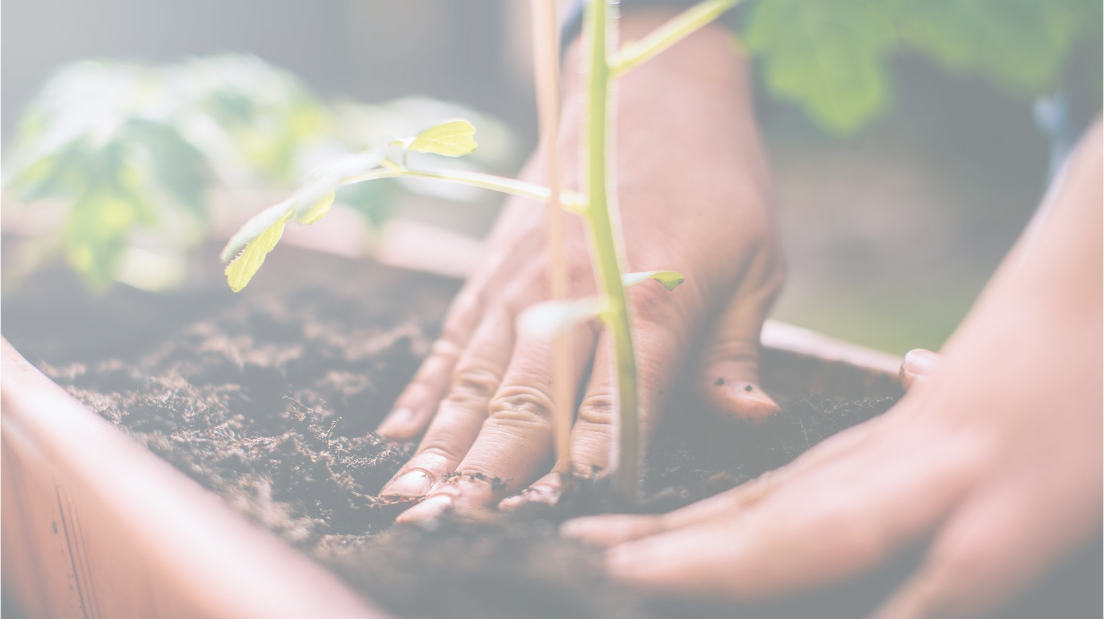



ACT: Architectural Carbon Modeling Tools
@ MICRO 2022
Tutorial
Udit Gupta

Slide 2
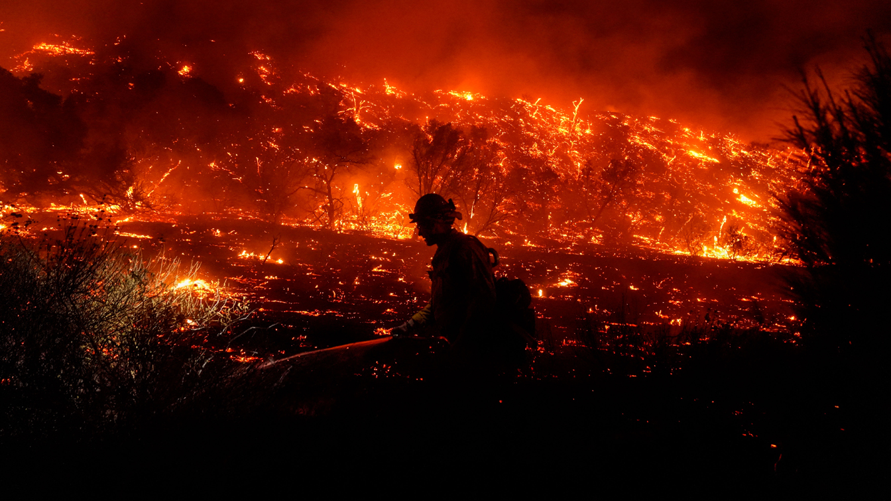

Slide 3
Climate change is an existential threat to our society that requires
immediate, collective actions across all communities and industries.

Slide 4
Over the last 20 years, hardware and software advancements have drastically optimized for performance and energy efficiency
Pre-2000:
“Dennard Scaling”
2000-2010:
“Dennard’s Hangover”
2010-2020: “Beyond Dennard”
Specialization: ~10x for key workloads
10x energy efficiency
every 5 years
10x energy efficiency over decade
Peak CPU Efficiency:
Still 10x over decade
Idle power optimization: ~10x for “typical” usage
PUE optimization: ~1.5x-2x for datacenters
Koomey et. al., 2011
Naffziger and Koomey, 2016
Notes:
Over the last 20 years, we’ve seen hardware and software advances dramatically improving performance and energy efficiency.
But the question we are interested in today is,

Slide 5
Over the last 20 years, hardware and software advancements have drastically optimized for performance and energy efficiency
Pre-2000:
“Dennard Scaling”
2000-2010:
“Dennard’s Hangover”
2010-2020: “Beyond Dennard”
Specialization: ~10x for key workloads
10x energy efficiency
every 5 years
10x energy efficiency over decade
Peak CPU Efficiency:
Still 10x over decade
Idle power optimization: ~10x for “typical” usage
PUE optimization: ~1.5x-2x for datacenters
Koomey et. al., 2011
Naffziger and Koomey, 2016
But how have these advances affected computing’s environmental sustainability (e.g., carbon footprint)?
Notes:
How have these advances affected computing’s overall environmental sustainability and more specifically carbon footprint.

Slide 6




Computing incurs a growing environmental footprint
1.2-2.2 Billion tons of CO₂
On par with the aviation industry’s footprint
2.1 - 3.9% of worldwide emissions (Freitag’21)
Data center
Mobile
Communication
Computing’s emissions are rising given its growing demand!
Notes:
When we aggregate computing environmental impact across mobile, communication, and data centers, studies show that computing accounts for 900 million metric tons of CO2.
That’s on par with the aviation industry’s footprint and around 2-4% of worldwide emissions.
Not only is this a huge amount already but we find that ICT emissions are expected to double over the next decade given the growing demand for computing.
And so it’s crucial that we as a community start think about what it means for computing itself to be sustainable.

Slide 7
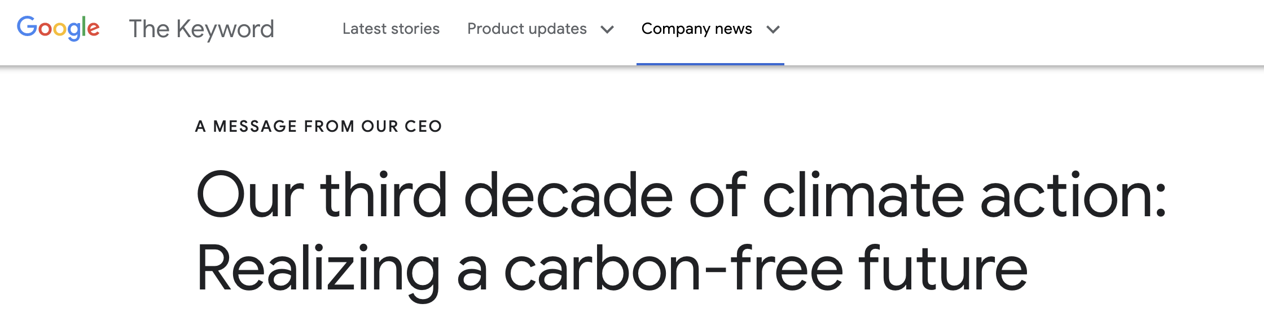
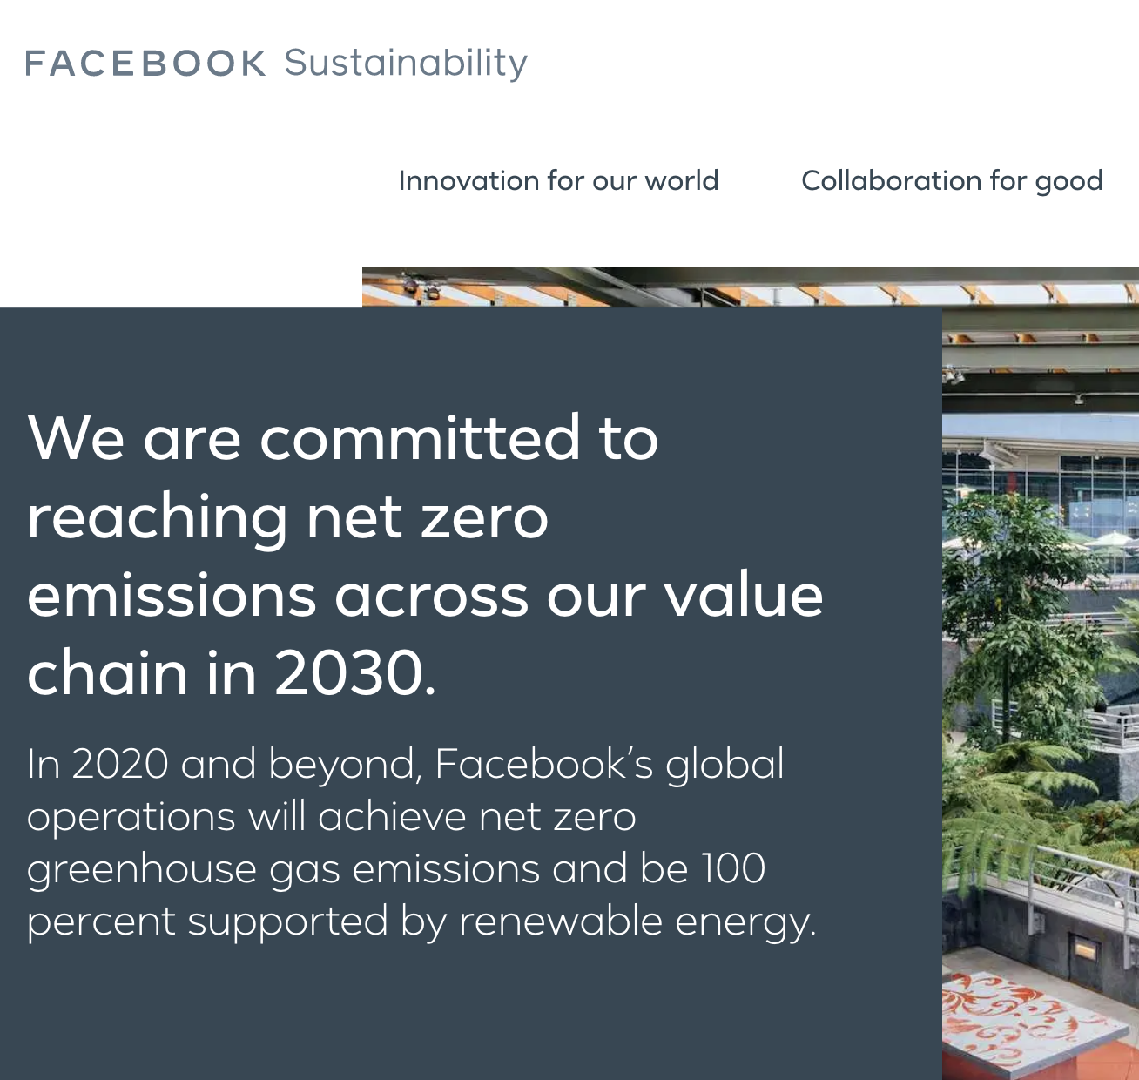
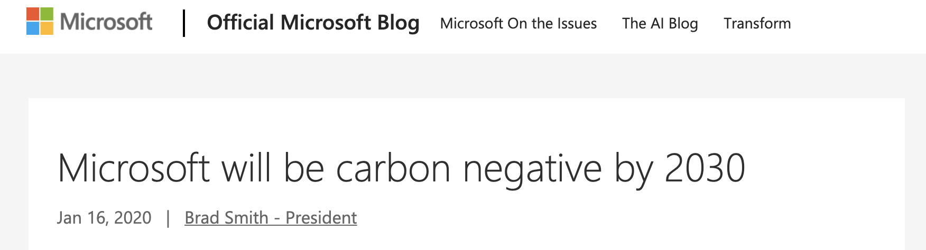
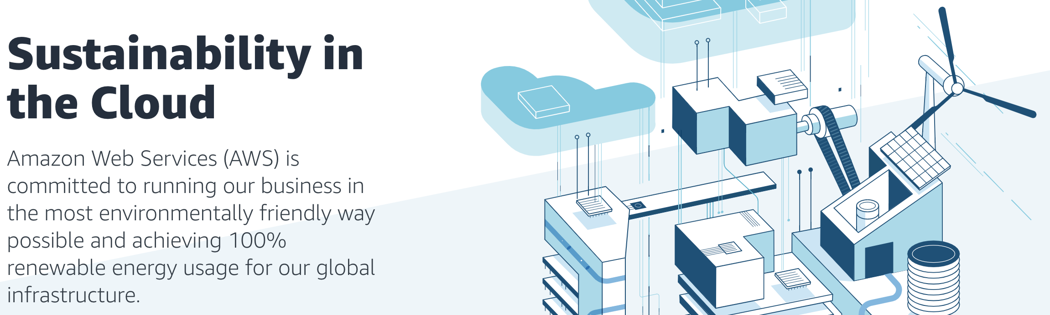
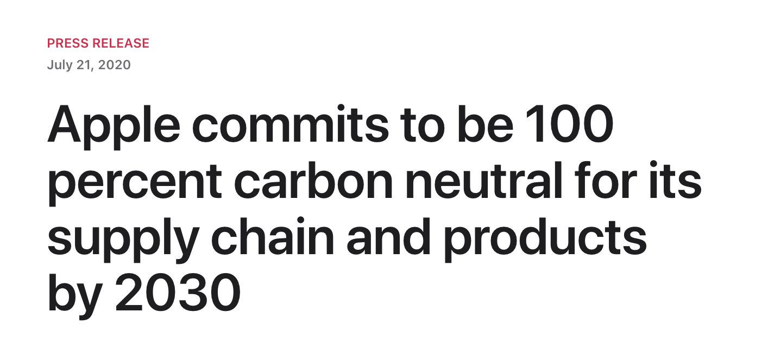
Big Tech. companies are pledging carbon neutrality
Notes:
For instance, Google, Microsoft, Facebook, Apple, Amazon, and others have pledged to reach carbon neutrality over the next decade.
In this talk we explore, what role computer systems and architecture researchers and developers can play in achieving sustainable computing going forward.

Slide 8
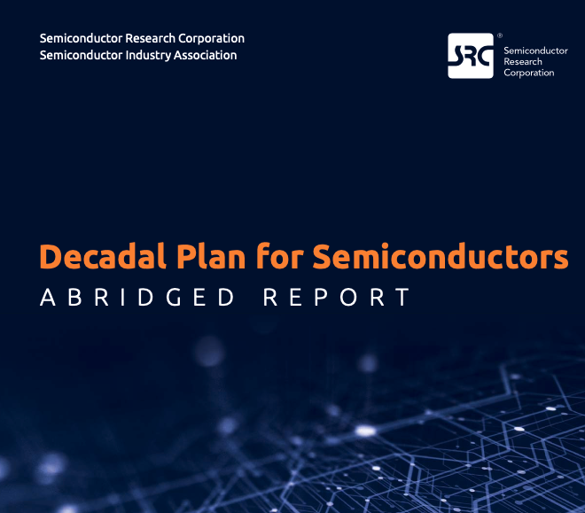
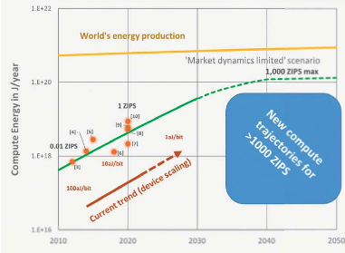
SRC decadal plan calls attention to ICT rising energy footprint
Ever-rising energy demand for computing vs. global energy production is creating new risk,
and new computing paradigms offer opportunities to dramatically improve energy efficiency.
Notes:
Specifically we ask the question, where does computing’s carbon footprint come from?
In our journey to answer this question what we found was quite surprising to some of our collaborators that have spent a lot of time thinking about hardware performance and energy efficiency optimizations.

Slide 9
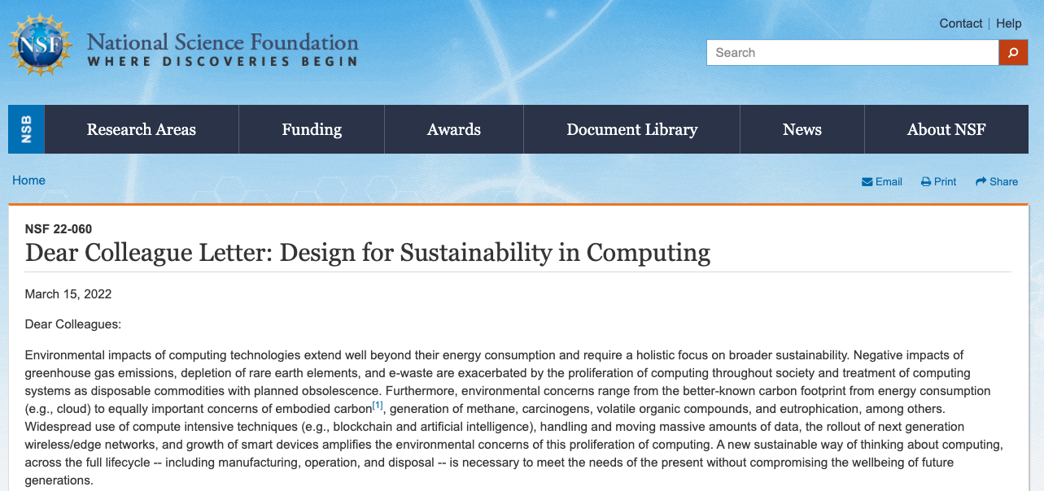
NSF Dear Colleague Letter on Sustainable Computing
DCL
VMWare NGSDI
SRC Decadal Plan
https://www.nsf.gov/pubs/2022/nsf22060/nsf22060.jsp

Slide 10
ACT Tutorial Motivation and Goals
Provide the necessary background and tools to enable researchers to incorporate sustainable as a first order design target
Provide a brief overview of the sustainability implications of modern systems,
Detail the ACT methodology,
Demonstrate how to use ACT,
Demonstrate how to extend ACT
Notes:
Specifically we ask the question, where does computing’s carbon footprint come from?
In our journey to answer this question what we found was quite surprising to some of our collaborators that have spent a lot of time thinking about hardware performance and energy efficiency optimizations.

Slide 11

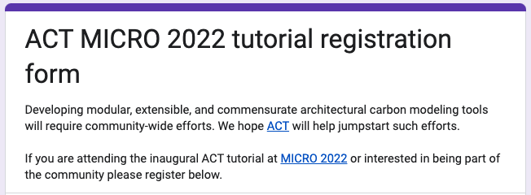
Sing up on our Google form!
https://forms.gle/hEAju2suaeEnisRQA

Slide 12

ACT Tutorial: Today
Time | Topic
1:00 – 1:15pm | Introductory remarks
1:15 – 1:30pm | Motivation: Understanding the source of computing’s emissions
1:30 – 2:15pm | Overview of ACT: An Architectural Carbon Modeling Tool
2:15 –2:30pm | Coffee Break
2:30 – 3:00pm | Hands-on ACT demo’s
3:00 – 3:15pm | Extending ACT
3:15 – 3:45pm | Office Hours
3:45 – 4:00pm | Closing remarks
Notes:
Finally, given our understanding of carbon emissions, we will conclude by charting paths for how to design future sustainable computing systems.

